Slide 1
Generative Adversarial Networks
An Introduction to GANs
Korey MacVittie

Slide 2
Overview
GANs are a type of neural network architecture
Two competing networks, the “discriminator” and “generator”
Discriminators learn to assign correct labels to input
Two inputs, one “real” and one “generated”
Generators learn to produce output that fools the discriminator
The end goal: predict features from label

Slide 3
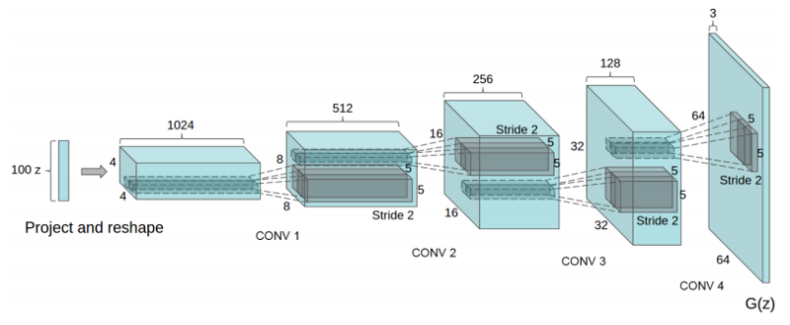
GAN Architecture

Slide 4
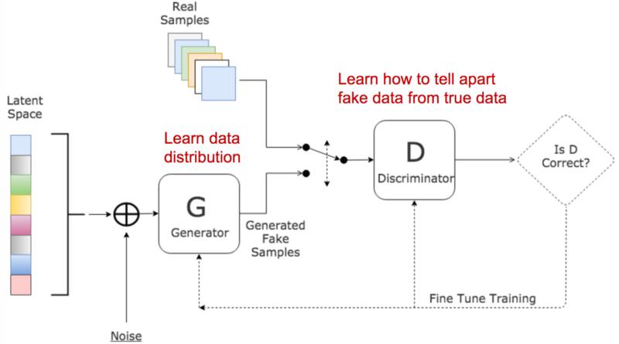

Slide 5
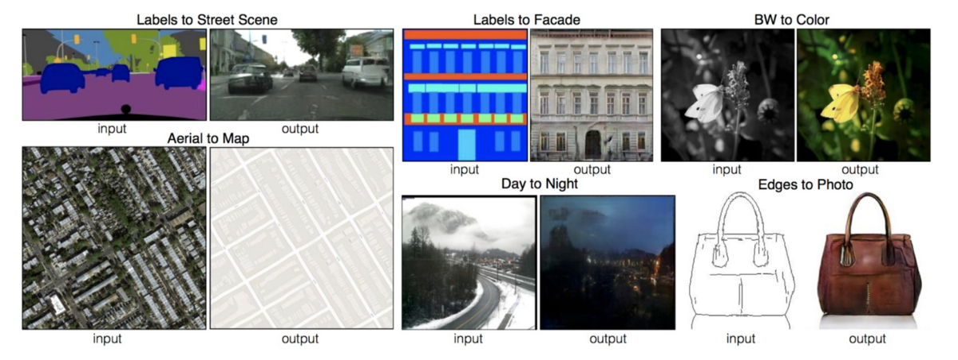
GAN Use Cases

Slide 6
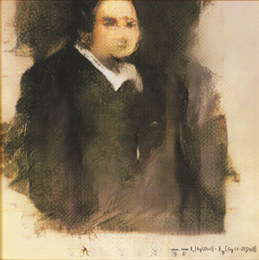
Edmond de Belamy
GAN-generated portrait
Produced in 2018
Sold at auction for nearly $500,000

Slide 7
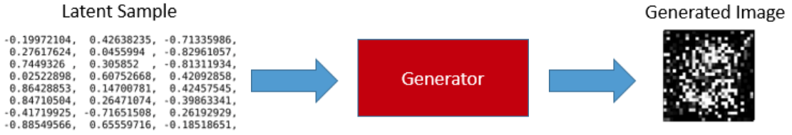
Generator
Generators typically begin by producing “garbage”
Uses back-propagation to improve generation
Relies on the discriminator

Slide 8
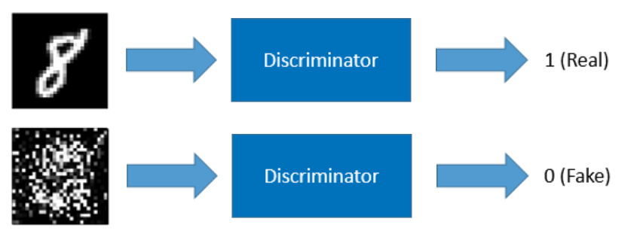
Discriminator
Requires known data
Training requires labeled and generated data

Slide 9
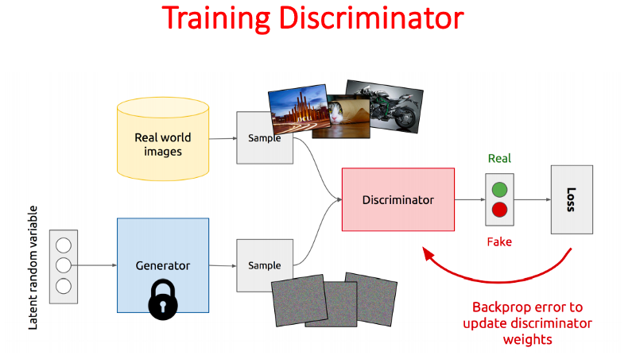
Gan Training Loop
Make the discriminator trainable
Train discriminator with both real and generated input

Slide 10
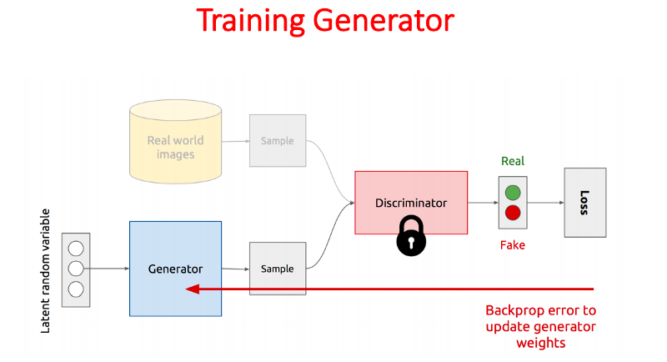
Gan Training Loop (Contd.)
Set the discriminator non-trainable
Relies on a trained discriminator

Slide 11
Problems
Subject to “mode collapse”
Generator trapped in local minimum
Much more difficult to train than most neural networks
Vanishing gradient much worse: two networks v. only one
Caution on training the discriminator
Looking to achieve a Nash equilibrium
No proper evaluation metric

Slide 12
Bibliography & Image Sources
https://medium.com/sigmoid/a-brief-introduction-to-gans-and-how-to-code-them-2620ee465c30
https://towardsdatascience.com/must-read-papers-on-gans-b665bbae3317
https://towardsdatascience.com/understanding-generative-adversarial-networks-4dafc963f2ef
https://towardsdatascience.com/generative-adversarial-networks-explained-34472718707a
https://towardsdatascience.com/art-of-generative-adversarial-networks-gan-62e96a21bc35
https://towardsdatascience.com/generative-adversarial-networks-gans-for-beginners-82f26753335e
https://towardsdatascience.com/graduating-in-gans-going-from-understanding-generative-adversarial-networks-to-running-your-own-39804c283399
https://medium.com/@sharimpervez/a-simple-introduction-to-generative-adversarial-networks-gans-8e327ff65f7c
https://medium.com/the-downlinq/artificial-colorization-of-grayscale-satellite-imagery-via-gans-part-1-79c8d137e97b
https://medium.com/deep-math-machine-learning-ai/ch-14-general-adversarial-networks-gans-with-math-1318faf46b43
https://towardsdatascience.com/generative-adversarial-networks-history-and-overview-7effbb713545
https://en.wikipedia.org/wiki/Edmond_de_Belamy

